Slide 1
Self-Awareness as a Key Secret to Success in Mediation
Ketevan Iremashvili, PhD in Law
Turiba University, Riga
April, 2019

Slide 2
Understanding Mediation Context in Georgia
Mediation has been actively promoted in Georgia since 2012
State’s interest: Changes in Legislation
Support of International Organizations: East West Management Institute, UNDP…
Raising awareness about mediation: training judges, attorneys, law professors, students

Slide 3
Understanding Mediation Context in Georgia
Current State of Development:
Law on Mediation introduced to the Parliament of Georgia
Mediation Association(s) Created
The Code of Professional Conduct/Ethics Code of Mediators Elaborated
Recruitment of Mediators increased

Slide 4
Understanding Mediation Context in Georgia
Variety of Mediation Types Utilized in the Country:
Court-Annexed/Mandatory Mediation on Private Law Cases
Collective Labor Dispute(s) Mediation
Mediation in Public Agencies
Mediation in Private Sector
Mediation for Juvenile/Restorative Justice
Mediation Clinic

Slide 5
Understanding Mediation Context in Georgia
Historical roots of Mediation in Georgia
Georgian character: temper, extremes
Cultural context: defensive mentality

Slide 6


Understanding Mediation Context in Georgia
Ushguli, Svaneti
Batumi, Adjara

Slide 7
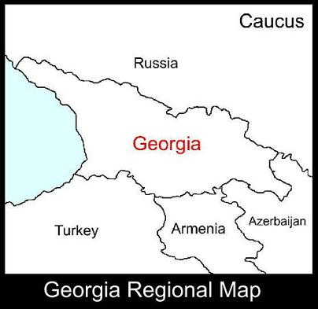
Understanding Mediation Context in Georgia

Slide 8

Understanding Mediation Context in Georgia

Slide 9

Understanding Mediation Context in Georgia
Georgian Greeting – Hello
Translates as
“I wish you to win”/
Winning

Slide 10
Self-Awareness as a Key Secret to Success in Mediation
Key Questions for Discussion:
What is Mediation?
How do we measure Success?
What do we imply under Self-awareness?
Why is all that related?

Slide 11
Self-Awareness as a Key Secret to Success in Mediation
Mediation is –
A voluntary mechanism of dispute resolution, an alternative to court;
Based on extended integration of parties into the process;
Performed mostly by verbal communication, through the means of conversation.

Slide 12
Self-Awareness as a Key Secret to Success in Mediation
Success of Mediation
Success of Mediation
Is measured not by the agreement as a result achieved at the end of the process;
But rather by the quality of communication provided through the process.

Slide 13
Self-Awareness as a Key Secret to Success in Mediation
Quality Communication rests on Universal Values, such as:
Listening - listening others not with the purpose to respond, but with the purpose to understand.
Understanding - the utilization of empathy, putting yourself in another person’s shoes, from objective and neutral perspective with the goal of accepting.
Accepting - facing the failure, admitting the loss and transforming negative record into experience.

Slide 14
Self-Awareness as a Key Secret to Success in Mediation
According to R.Fisher and W. Ury Interest-Based Negotiation Strategy
Quality Communication implies:
Separation of Problems from People;
Distinction of Claims/Demands and Interests.

Slide 15
Self-Awareness as a Key Secret to Success in Mediation
The real separation of people from problems – requires to undergo several steps of self-awareness, namely:
The accurate diagnosing of emotion and its addressee.
The understanding of addressee’s condition in the moment when your emotion was formed and accepting his or her behavior as a resemblance of his or her own emotional condition and as a respond to his or her own addressee.
There’s a saying:
“They’re not so much against you as they are for themselves.”

Slide 16
Self-Awareness as a Key Secret to Success in Mediation
The real differentiation between claims/demands and interests happens only after revealing one’s real interests as a result of an emotional journey in subconscious.
There’s a simple formula: to understand who you are and what you want you start with clarifying who you’re not and what you don’t want. This is already a half and the most important step forward.
Such a level of realization leads parties to easily let go the things they’re not struggling for in reality, rather rationalize the use of their energy and put efforts in what they’re really seeking for. !!!

Slide 17
Self-Awareness as a Key Secret to Success in Mediation
After ideas and patterns presented we may ask a very logical question:
How shall mediator produce the level of such a deep and an insightful communication:
For the parties with themselves?
For parties among each other?
There’s no magic. The answer is simple:
In order to coach the soldiers one has to have been at war.

Slide 18
Self-Awareness as a Key Secret to Success in Mediation
What is Self-awareness and why its important?
Self-awareness is a primary and integral element of Emotional Intelligence
Emotional Intelligence is regarded to be a competitive advantage for wide range of professionals
EQ plays important role specifically for mediators because their task is navigating a dynamic process allowing as much emotional bursts from parties as necessary

Slide 19
Self-Awareness as a Key Secret to Success in Mediation
Despite the variety of definitions of Emotional Intelligence, these two elements are always present:
The ability to self-control
The ability to control the environment
There is a logical sequence between the two: the “second” can’t be achieved without the “first”
How can one steer the external process and be a leader if there’s no leadership within?
Remember the ship sinks not when its in the water, but when the water is in it…

Slide 20
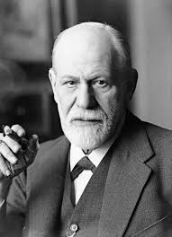
Self-Awareness as a Key Secret to Success in Mediation
There’s no worse enemy than Self.
The only one a person has to compete with is the self.
Remember Sigmund Freud
There’s why we may argue that the efficiency of communication with the other person depends on one’s ability to communicate with the self.

Slide 21
Self-Awareness as a Key Secret to Success in Mediation
What shall be Mediator’s expected minimum knowledge regarding emotions.
In a highly competitive world, an effective mediator shall note, for example, the following:
When a person seeks to be understood, in fact s/he suffers from the lack of self-understanding. In other words, often there is no real ground for conflict with the other person because the conflict the person has is with self.
The ID age of a person does not always resonate with one’s emotional maturity. Often people with influential titles enter into a conflict with a childish attitude as they stick to “stupid principles” instead of rationalization.
The real objective reasons of most problems are originated from suppressed anger and are related with unfinished emotional scenarios in human brain.
………

Slide 22
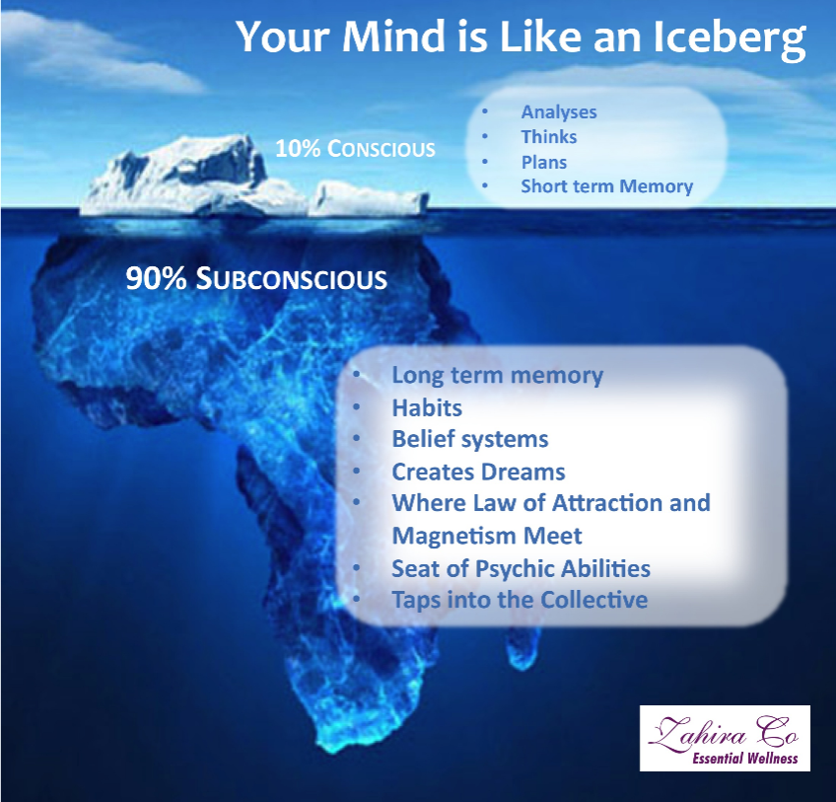
Self-Awareness as a Key Secret to Success in Mediation
Mediator has to have an awareness about the distinction of conscious and subconscious of human mind. This will help the Mediator to:
Observe connection between one’s verbal and bodily expression, accurately read non-verbal signals.
Differentiate among emotions.

Slide 23
Self-Awareness as a Key Secret to Success in Mediation
Mediator has to be aware about the separate “departments” of human brain and their functions:
Neocortex – an intellectual brain, responsible for decisions we make
The Limbic/Emotional brain, stimulator of our actions, including panic attacks
Difference between the two,
Daniel Goleman’s example

Slide 24
Self-Awareness as a Key Secret to Success in Mediation
Mediation is an educational process. And like in contemporary progressive educational system, mediation rests on the principles of empowerment and autonomy of participants of the process. Mediator faces the hardest task to create an educational environment, i.e. environment where people:
Feel safe;
Trust the process;
Are open to learn.

Slide 25
Self-Awareness as a Key Secret to Success in Mediation
If compared with lawyer-client relationship, it will get obvious that certain professional duties gain higher and heavier meaning for Mediator:
Mediator is under the constant pressure of maintaining impartiality which threatens the formation of trust necessary for the process. Mediator is bounded by Fiduciary, so called bona fide duties from both sides.
Mediator’s duty of confidentiality applies to processes within and outside of mediation. The piece of information provided by the parties needs to stay confidential from the other party when private sessions with mediator are used.

Slide 26
Self-Awareness as a Key Secret to Success in Mediation
As a choice in life, Self-awareness is optional. People explore themselves in various ages, at different stages of their life and in a variety of ways.
However, for professions like of a Mediator, Self-awareness is not a choice anymore. Rather, it is an obligation, excepted mastery stipulated by the role and task of Mediator.

Slide 27
Self-Awareness as a Key Secret to Success in Mediation
Given the conditions described above the following recommendations apply:
It is necessary to elaborate an interdisciplinary training program for mediators as a part of their preparation;
The training has to be provided by a pair of trainers – a lawyer and a physiologist with an extended use of interdisciplinary approach;
The training shall be designed as an optional and advanced part of preparation process and shall have to do nothing with certification;
The training shall involve smaller groups of participants with extended elements of exercises used in psychotherapy.

Slide 28

A
BIG
GEORGIAN
THANK YOU!!!

